Slide 1

Corrupted Blood: A Virtual Epidemic in World of Warcraft
Adrien Christiaën & Christophe Hoyau

Slide 2

Introduction
Adrien Christiaën

Slide 3
Quick Overview
Main events
September 13, 2005: Release of Patch 1.7 in World of Warcraft triggers the Corrupted Blood plague in Zul’Gurub.
September 16, 2005: First report of the plague appears on the WoW forum.
September 16-17, 2005: Blizzard implements quarantines to contain the spread of the disease.

Slide 4
Quick Overview
Impact and Characteristics of the Plague
Approximately 4 million players encounter the epidemic in WoW in September 2005.
Disease's R0 in capital cities and transport hubs reaches around 10² per hour.
Quarantine efforts fail due to high contagiousness and player resistance.
PvP in non-contested areas provides immunity against the plague from non-PvP flagged players.

Slide 5
Quick Overview
Player Responses and Disease Characteristics
Players act as first responders, utilizing pets as vectors for the disease.
Teleportation aids the spread over long distances.
Some players avoid urban areas or leave the game.
NPCs act as asymptomatic carriers, complicating containment efforts.
Player emotional investment in the game leads to resistance against quarantine measures.

Slide 6

The Spell: Corrupted Blood
Main Characteristics
Effect: Inflicts 263 to 337 damage every 2 seconds and spreads to nearby allies.
Duration: 4 seconds
Range: 100 yards
Schools: Physical damage
Cooldown: None
Periodic trigger: Every 2 seconds
Classes affected: Not specified

Slide 7
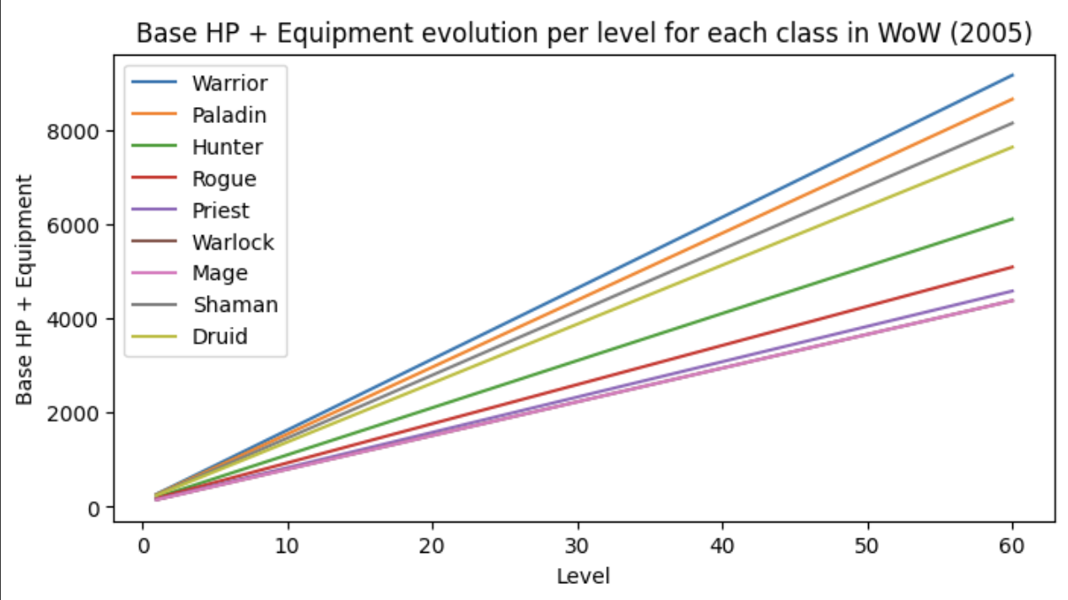
Data on the plague
Evolution of Healths Points for each class
HP ranging from an average of 80 HP to 9000 HP.

Slide 8
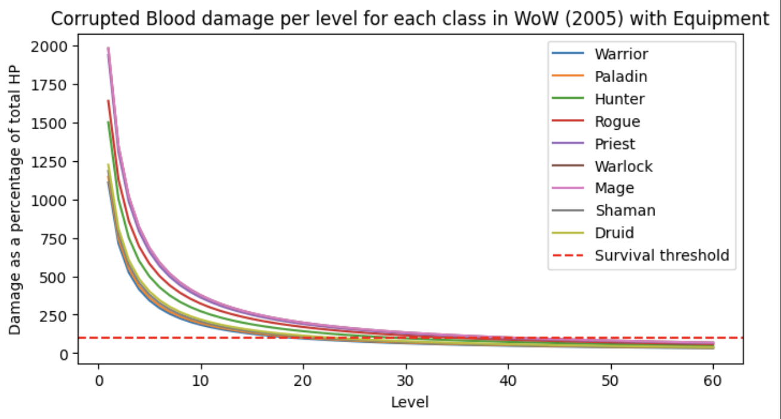
Data on the plague
Evolution of Damage taken for each class
Survival threshold levels with equipments:
Warrior: Level 19
Paladin: Level 20
Hunter: Level 28
Rogue: Level 34
Priest: Level 38
Warlock: Level 40
Mage: Level 40
Shaman: Level 21
Druid: Level 23
Average level = 30.22

Slide 9
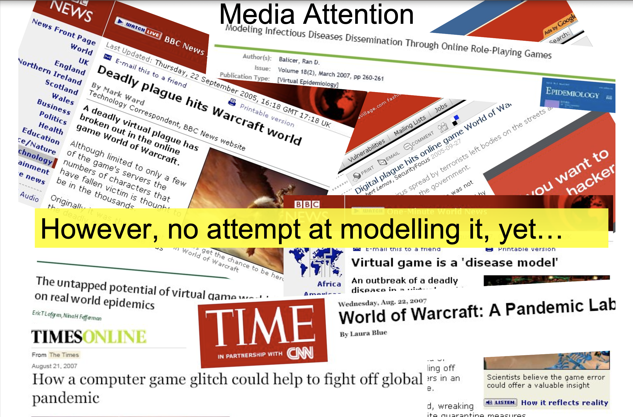
Quick Overview
Approximation

Slide 10
Geneticals Algorithms (GA) Application
Christophe Hoyau

Slide 11
GENETICALS ALGORITHMS APPLICATION
Approximation
Class distribution: Classes are generated randomly with equal probability 1/9.
When individuals heal themselves or others, they restore the entire health.
Below these levels, players automatically die if they are infected

Slide 12
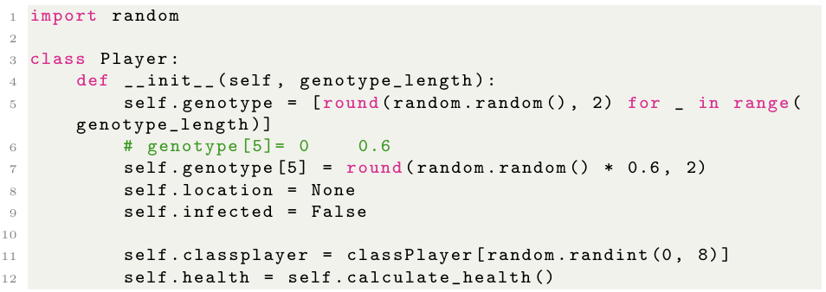
GENETICALS ALGORITHMS APPLICATION
Model -- Player
0 to 1
genotype[0]: flee from an infected area
genotype[1]: help other players
genotype[2]: spread the virus
genotype[3]: explore infected areas
genotype[4]: Preference for self-treatment
genotype[5]: Virus resistance/level (0 = low, 0.6 = high)
genotype[6]: Movement speed
genotype[7]: Location
Exemple :
[0.03, 0.79, 0.0, 0.65, 0.28, 0.54, 0.28, 0.5]
Santé: 6874.32
role: druid

Slide 13
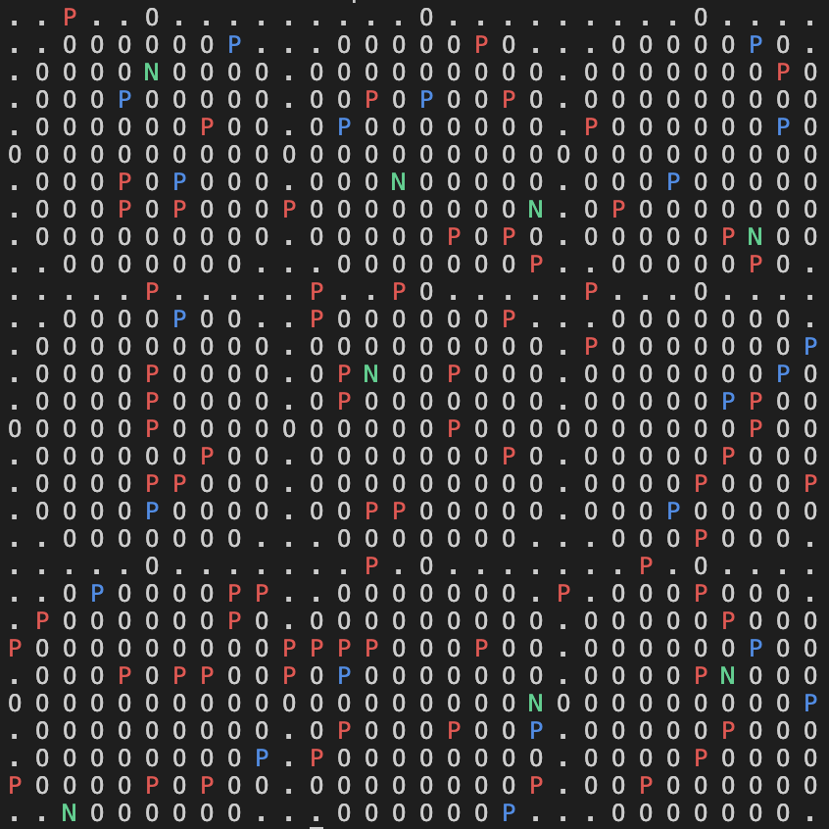
GENETICALS ALGORITHMS APPLICATION
Model -- Map
Representation of a Map

Slide 14
GENETICALS ALGORITHMS APPLICATION
First Step
One step represent :
Those who are infected lose HP or die.
Heals genotype[1] and/or heals other genotype[4].
Move % according to genotype[6] for distance and #genotype[0], [3], and [7].
Infects other players #genotype[2].

Slide 15
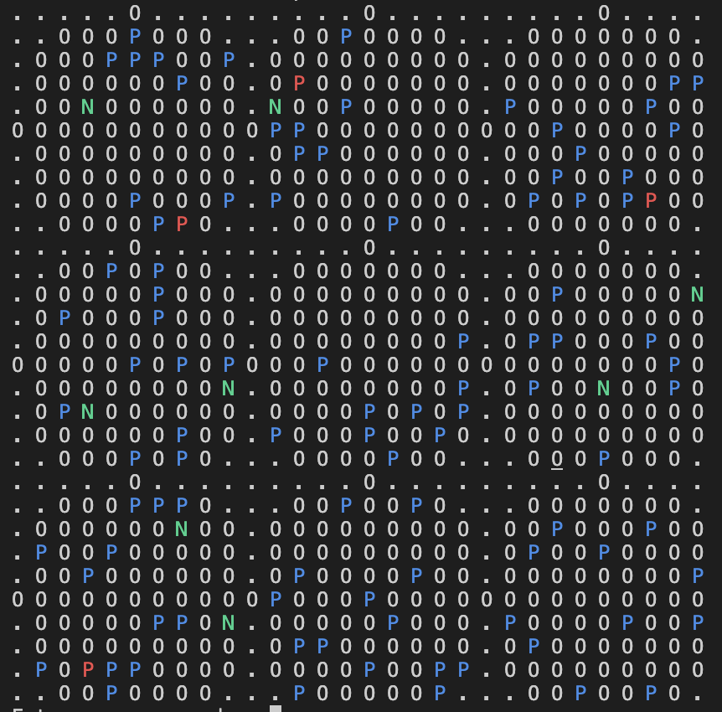
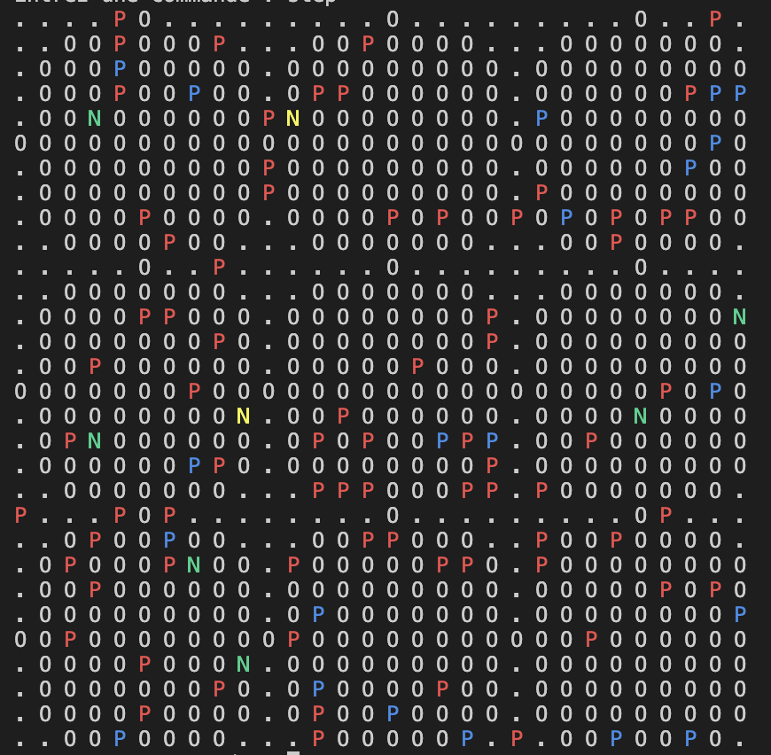
GENETICALS ALGORITHMS APPLICATION
Model -- Map
After one step
Map after the beginning
Map after the first step

Slide 16
GENETICALS ALGORITHMS APPLICATION
Implementation of the genetic algorithm
Fill population missing
population
population
sort population
100 players
Best
50%
20 steps
Mutation
25%
Cross-over
25%
Repeat 100 times

Slide 17
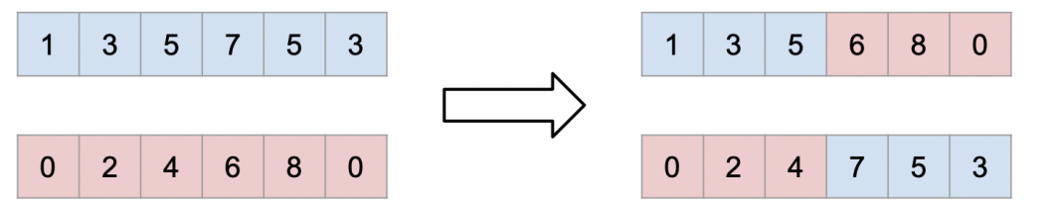
GENETICALS ALGORITHMS APPLICATION
Implementation of the genetic algorithm
One point cross-over
Mutation
20% chance of modifying a gene

Slide 18
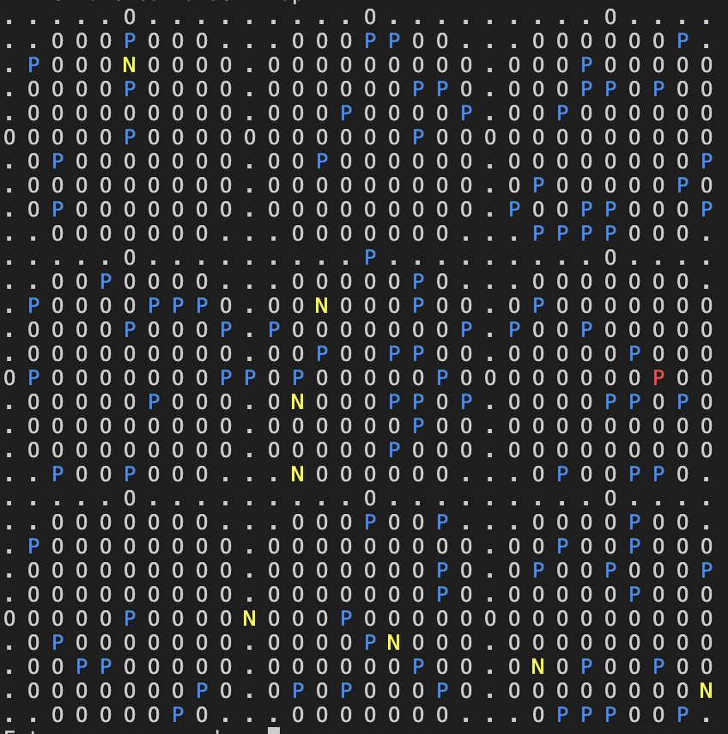
GENETICALS ALGORITHMS APPLICATION
Implementation of the genetic algorithm
After many steps
Average : [0.73, 0.67, 0.58, 0.62, 0.63, 0.49, 0.55, 0.61]
15% of hunter
17% of warrior
21% of druid
30% of paladin
12% of shaman
2% of mage
1% of priest
2% of rogue
0% of warlock

Slide 19
Particle Swarm Optimization (PSO) Algorithm Application
Adrien Christiaën

Slide 20
PSO Algorithm Application
Simulation Parameters
Spell data:
Player Behavious data:
Duration | 4 seconds
Damage | 263 to 337 every 2 seconds
Trigger Period | Every 2 seconds
Range | 100 yards
Initial Population: 100 players | 100 players
R0 | 10

Slide 21
PSO Algorithm Application
Simulation Parameters
Health Classes (HP):
Warrior: HP = 150.51 × level + 120 Paladin: HP = 142.03 × level + 120 Hunter: HP = 100.00 × level + 100 Rogue: HP = 83.05 × level + 100 Priest: HP = 74.92 × level + 80 Warlock or Mage: HP = 71.53 × level + 80 Shaman: HP = 133.56 × level + 120 Druid: HP = 125.08 × level + 120

Slide 22
PSO Algorithm Application
Problem and fitness function
Health Classes (HP):
To implement player behavior, we consider 8 factors:
Initial Infected: The starting number of infected players.
Quarantine Effectiveness: Measures how well quarantine reduces spread.
Familiar Effect: Impact of player familiars on disease transmission.
Teleportation Effect: How player teleportation affects spread.
Urban Avoidance Effect: How player avoidance of urban areas affects spread.
Quarantine Effort Intensity: Level of quarantine efforts to reduce spread.
PvP Immunity: Players' immunity in PvP areas.
NPC Asymptomatic Effect: Contribution of asymptomatic NPCs to spread.
Infected players = initial_infected * transmission_rate
assess fitness calculate the total infected players across different player classes

Slide 23
PSO Algorithm Application
Algorithm 1: Particle Update
Algorithm :
- Initialize particle with problem, velocity, position, and index.
- While not at stopping criterion:
- Assess fitness.
- Update position and velocity using PSO algorithm.
- If current fitness is better than previous fitness, update fittest position.
- Update previous fitness.

Slide 24
PSO Algorithm Application
Algorithm 2: Particle Swarm Optimization (PSO) Algorithm
Algorithm:
- Initialize PSO algorithm with problem, swarm size, and vector length.
- Initialize swarm with random particles and select global fittest particle.
- While not at stopping criterion:
- Update each particle in the swarm.
- Update the global fittest particle.
- Procedure to update swarm:
- Select informants for each particle.
- Update particle's position and velocity.
- Procedure to update global fittest:
- Find the fittest particle in the swarm.
- Update the global fittest particle if necessary.

Slide 25
PSO Algorithm Application
PSO Parameters
Swarm size: 100 #Number of particles in the swarm
Vector length: 8 #Length of the particle’s position vector
Number of informants: 6 #Number of informants each particle considers
Number of iterations: 50 #Number of iterations for PSO algorithm

Slide 26
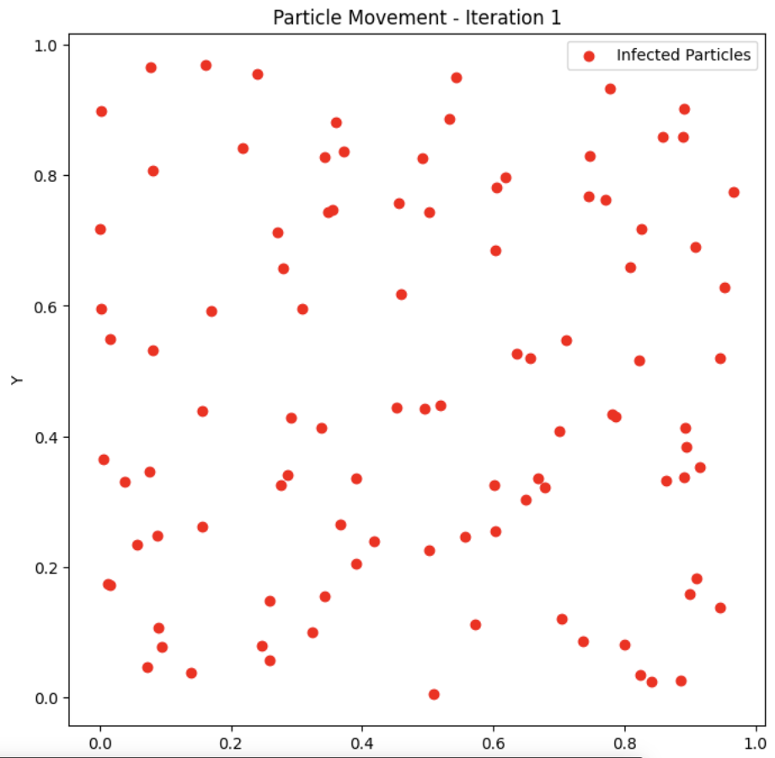
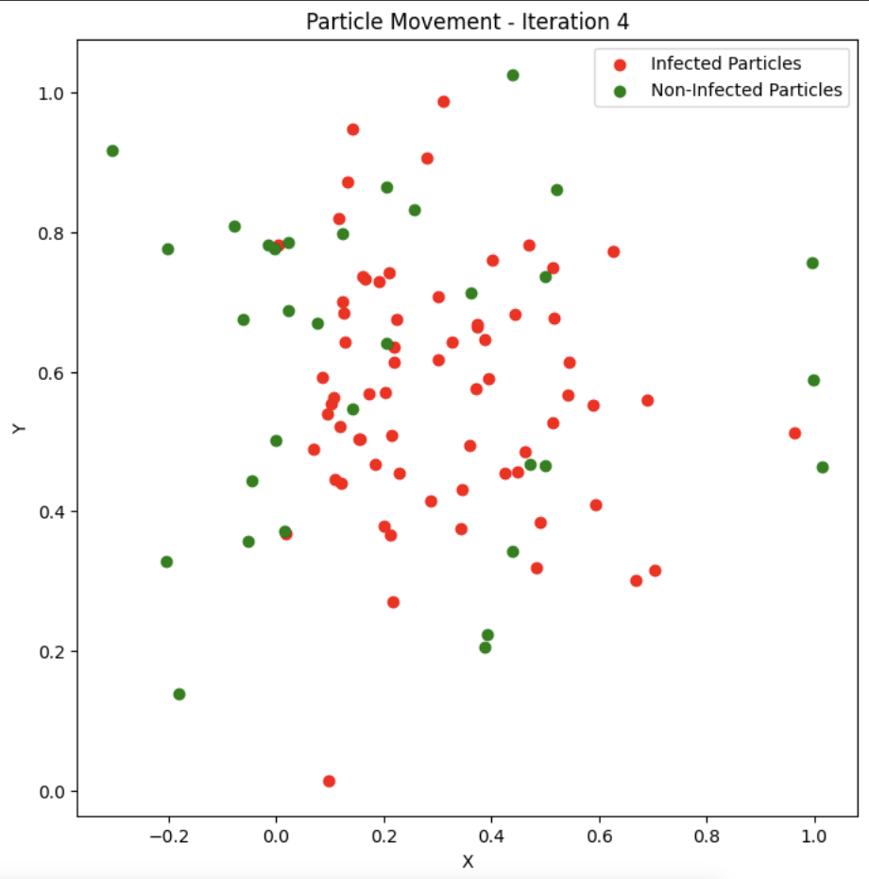
PSO Algorithm Application
Results -- Particle Movement
After 4 steps
Map after one step
Map after 4 steps

Slide 27
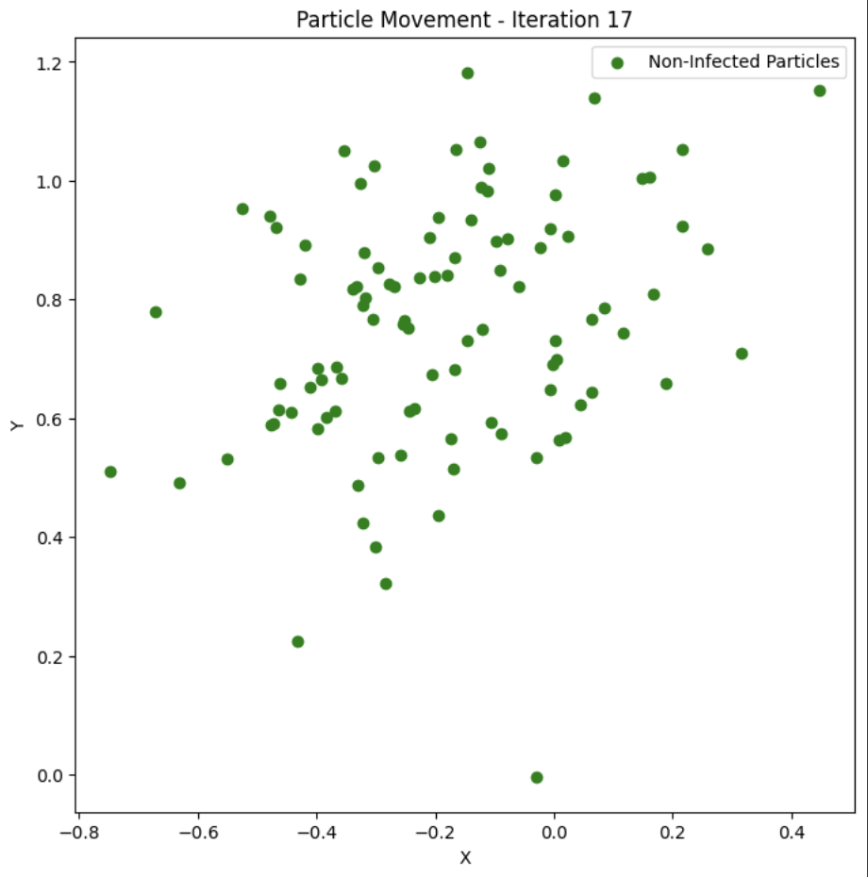
PSO Algorithm Application
Results -- Particle Movement
Map after 17 steps

Slide 28
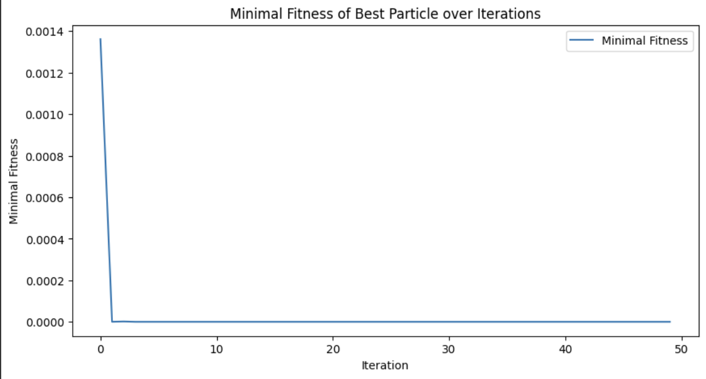
PSO Algorithm Application
Results – Fitness Function Evolution
Iteration 1: Optimal position: [0.28369422 0.78165879 0.60525805 0.51457356 0.64825731 0.84568558 0.53459093 0.44621638], Minimal number of infections: 0.001361580460492823
Iteration 2: Optimal position: [0.16229635 0.69928461 0.66261453 0.99818547 0.01962598 0.99254038 0.37520945 0.79124488], Minimal number of infections: 2.3369458025629572e-07
Iteration 3: Optimal position: [0.73733214 0.98379183 0.96503727 0.67752901 0.56236019 0.97180068 0.56420892 0.72919689], Minimal number of infections: 1.6091418676585886e-06
Iteration 4: Optimal position: [0.38748463 0.58488801 1.00699252 0.41513287 0.71400473 0.44510443 0.4132108 0.29456233], Minimal number of infections: 0.0
Easy to see that after 4 iterations, it’s equal to 0

Slide 29
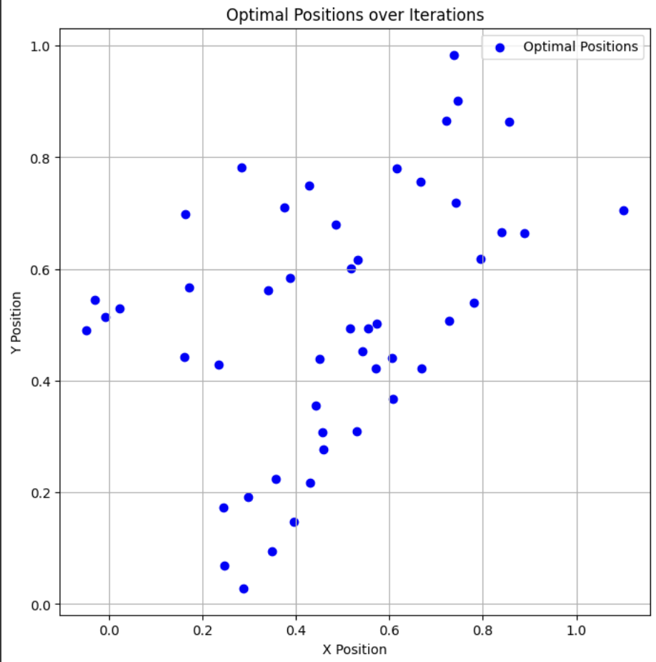
PSO Algorithm Application
Results – Optimal Positions
Optimal positions always changing

Slide 30
PSO Algorithm Application
Results – Simulation Results
Optimal position: [0.28310013, 0.56340775, 0.73298826, 1.1266275, 0.87363575, 1.18829493, 0.58170003, 0.96220079]
Minimal number of infections: 0.0 (drops to 0 after 4 iterations.)
All particles are non-infected after 17 iterations.
Average survival level: 28.90
Percentage of remaining players by class:
• Paladin: 14.49%
• Hunter: 14.49%
• Mage: 14.49%
• Warrior: 14.49%
• Priest: 10.14%
• Rogue: 10.14%
• Druid: 7.25%
• Shaman: 7.25%
• Warlock: 7.25%

Slide 31
Conclusion
Christophe Hoyau

Slide 32
GA vs PSO
Comparaison
Percentage of remaining players by class using GA:
15% of hunter
17% of warrior
21% of druid
30% of paladin
12% of shaman
2% of mage
1% of priest
2% of rogue
0% of warlock
Pertage of remaining players by class using PSO:
• Paladin: 14.49%
• Hunter: 14.49%
• Mage: 14.49%
• Warrior: 14.49%
• Priest: 10.14%
• Rogue: 10.14%
• Druid: 7.25%
• Shaman: 7.25%
• Warlock: 7.25%
- Both GA and PSO are effective in mitigating disease spread in virtual environments.
- GA evolves player behaviors over multiple generations through an iterative approach.
- PSO optimizes parameters directly, resulting in faster convergence and precise optimization.
- The choice between GA and PSO depends on factors like time constraints and modeling preferences.

